Slide 1
Topic 8: Gravitational Field
8.1 Gravitational field
8.2 Force between point masses
8.3 Field of a point mass
8.4 Field near to the surface of the Earth
8.5 Gravitational potential

Slide 2
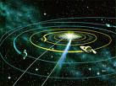
Planetary Orbits
The planets are revolving around the Sun.
They are making circular motion!

Slide 3
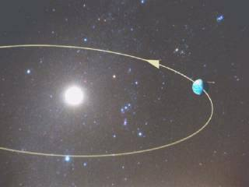
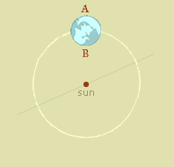
The Earth Orbits Round the Sun

Slide 4
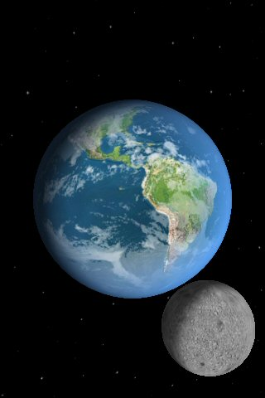
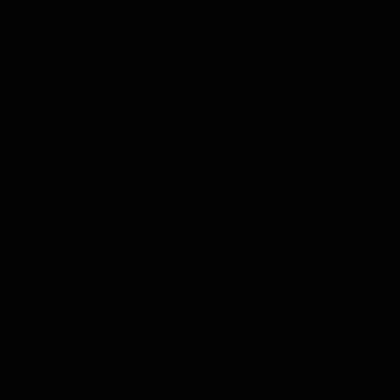
The Moon Orbits Around the Earth

Slide 5

Newton said it’s the Gravitational Force!

Slide 6
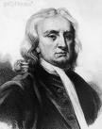
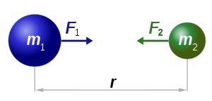
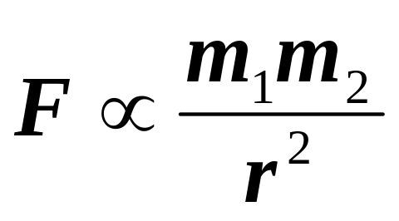
Newton’s Universal Law of Gravitation
In 1687 Newton proposed the Law of Gravitation:
“Every particle of matter in the universe attracts every other particle with a force which is directly proportional to the product of their masses and inversely proportional to the square of their distance apart.”

Slide 7
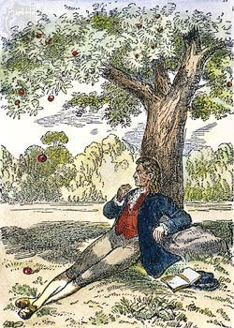
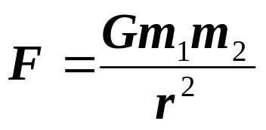
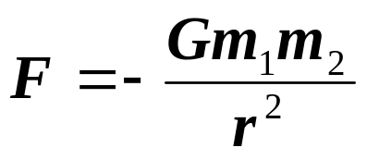
Newton’s Universal Law of Gravitation
It all started with an apple falling.
Where G = Gravitational Constant
= 6.67 × 10⁻¹¹ Nm²kg⁻²
This is a universal law, it applies to all masses.
Gravitational force is sometimes written as negative. The negative sign indicates attractive force.

Slide 8
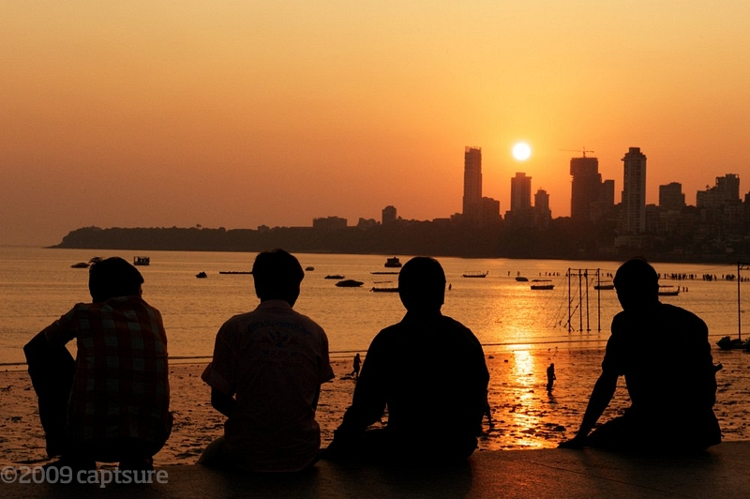
Gravitational Force: Example 1
Determine your mass and the mass of your friend sitting next to you. Assuming that both of you are sitting 0.5 m apart, calculate the attractive force between you and your friend.
(G = 6.67 × 10⁻¹¹ Nm²kg⁻²)
Solution:
Assuming that your mass is 60 kg and that of your friend is 70 kg:
F = Gm₁m₂ / r²
= (6.67 × 10⁻¹¹ × 60 × 70) / (0.5)²
= 1.1 × 10⁻⁶ N
Gravitational force between 2 small masses is negligible

Slide 9
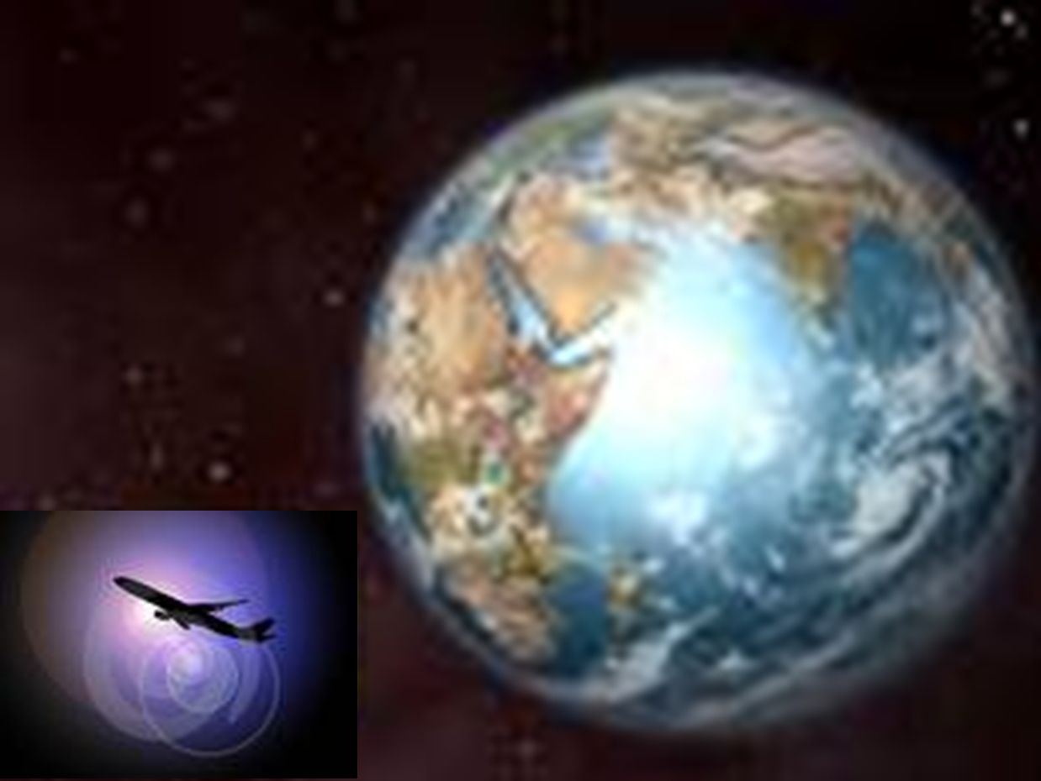
Gravitational Force: Example 2
The Earth may be considered to be a sphere of mass 6.0 × 10²⁴ kg and radius 6.38 × 10⁶ m. Assume that your mass is 60 kg.
Calculate the gravitational force acting on you
(a) at the Earth’s surface
(b) if you are in an aeroplane, 100 km above the Earth’s surface.
Solution:
(a) F = GmM/R²
= (6.67 × 10⁻¹¹ × 60 × 6.0 × 10²⁴ ) / (6.38 × 10⁶)²
= 590 N
(b) 100 km = 0.10 × 10⁶ m
Distance from the centre of the Earth, R = (6.38 + 0.10) × 10⁶ m
F = GmM/R²
= (6.67 × 10⁻¹¹ × 60 × 6.0 × 10²⁴ ) / (6.48 × 10⁶)²
= 572 N
Gravitational force between two masses decreases when the distance between them increases

Slide 10

Gravitational Force: Example 3
The gravitational force between 2 equal masses, m, is 90 N. The distance between them is r. Determine the gravitational force when
(a) one of the masses is doubled
(b) both the masses are doubled
(c) r is doubled while m remains constant
(d) one mass is doubled and r is tripled.
Solution:
F = Gmm/r² = 90 N
(a) F = G(2m)m/r² = 2 × 90 = 180 N
(b) F = G(2m)(2m)/r² = 4 × 90 = 360 N
(c) F = Gmm/(2r)² = 90 / 4 = 22.5
(d) F = G(2m)m/(3r)² = (2/9) × 90 = 20 N

Slide 11

Gravitational Force: Example 4
A spacecraft is momentarily stationary at a distance of 3.8 × 10⁸ m from the centre of the Earth. The mass of the spacecraft is 350 kg and that of the Earth is 6.0 × 10²⁴ kg.
(a) Calculate the gravitational force acting at that position on
(i) the spacecraft
(ii) an object of 10 kg in the spacecraft
(b) Calculate the initial acceleration of the 10.0 kg mass if it is released from the aircraft.
Solution:
(a) (i) F = GmM/R²
= (6.67 × 10⁻¹¹ × 350 × 6.0 × 10²⁴ ) / (3.8 × 10⁸)²
= 0.97 N
(ii) F = GmM/R²
= (6.67 × 10⁻¹¹ × 10 × 6.0 × 10²⁴ ) / (3.8 × 10⁸)²
= 0.028 N
(b) F = ma
a = F/m = 0.028 / 10 = 2.8 × 10⁻³ ms⁻²
g decreases with distance

Slide 12
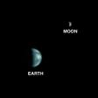
Gravitational Force: Example 5
The mass of the Earth is 5.98 × 10²⁴ kg and that of the moon is 7.35 × 10²² kg. The distance between the centre of the Earth and the centre of the Moon is 3.85 × 10⁷ m.
Calculate
(a) the gravitational force between the earth and the moon.
(b) the net force on an object of mass 100 kg, placed 1.85 × 10⁷ m from the Earth along the line joining the centre of the Earth and the centre of the moon.
Solution:
(a) F = GmM/R²
= (6.67 × 10⁻¹¹ × 5.98 × 10²⁴ × 7.35 × 10²² )
(3.85 × 10⁷)²
= 1.98 × 10²² N
(b) F_{net} = F_{E} – F_{m} = GmM_{E}/R² − GmM_{m}/(R−d)²
= 6.67 × 10⁻¹¹ × 100 [5.98 × 10²⁴ / (1.85 × 10⁷ )² − 7.35 × 10²² / (2.00 × 10⁷ )²]
= 115 N towards Earth

Slide 13
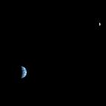
Gravitational Force: Example 6
The mass of the Earth is 5.98 × 10²⁴ kg and that of the moon is 7.35 × 10²² kg. A spacecraft travelling from the Earth to the Moon will reach a point X where it experiences no resultant gravitational force. The distance between the centre of the Earth and the centre of the Moon is 3.85 × 10⁷ m.
Draw a free-body diagram of the spacecraft at X.
Calculate the distance from X to the centre of the Moon.
Describe the motion of the spacecraft before reaching X and after leaving.

Slide 14
Solution 6
E
X
d
M
D = 3.85 × 10⁷ m
M_{M} = 7.35 × 10²² kg
M_{E} = 5.98 × 10²⁴ kg
(b) GmM_{E} / (D-d)² = GmM_{M} / d²
M_{E} d² = M_{M} (D - d)²
(5.98 × 10²⁴) d² = 7.35 × 10²² (3.85 × 10⁷ – d)²
d = 3.84 × 10⁶ m;
(c) Before reaching X, the spacecraft was decelerating;
after leaving X it’s accelerating

Slide 15
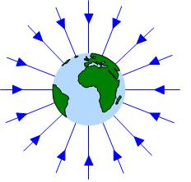
Gravitational Field
Every mass will create around itself a gravitational field.
However, the gravitational fields created by small masses are insignificant and is negligible.
Only field created by very big masses like the Earth and other planets are significant.
The field lines are radial and are directed to the centre of the mass.
The field lines are spread further apart as we move away from the mass. This indicates that the field strength gets weaker as we move further away.

Slide 16
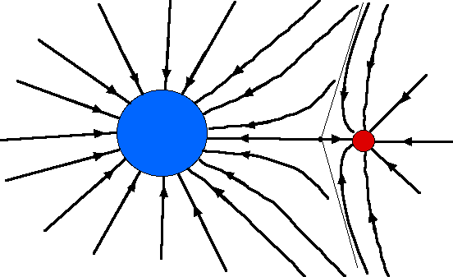
Field Lines for More Masses
Draw the gravitational field lines for
(a) Earth (b) the moon (c) the Earth and moon together
(d) Two equal masses together

Slide 17
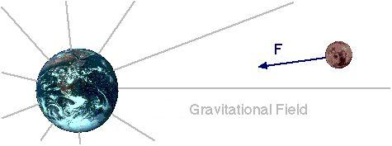
Gravitational Field Strength
The gravitational field strength is denoted by g.
The gravitational field strength at a point, is defined as the force per unit mass exerted on a mass placed at that point.
From this definition derive a formula for g:
Unit is
N kg⁻¹
g = F / m
F = G Mm / r²
Therefore, g = GM / r²
r
m
M

Slide 18
Unit of g
Unit of g is Nkg⁻¹ [(g = GM/R²) or (g = F/m)]
OR ms⁻² [Nkg⁻¹ = (kgms⁻²)kg⁻¹]
The gravitational field strength of Earth at its surface is 9.8 Nkg⁻¹
OR
We say that Earth’s gravitational acceleration of free fall at its surface is 9.8 ms⁻².

Slide 19
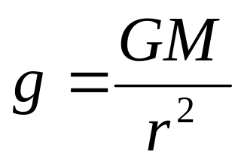
Big G and small g
g
m
r
M
g is the gravitational field strength at a point, r distant from the body of mass M that is creating the field. It varies with M and r.
G is the gravitational constant, it’s a universal value that does not change.
G = 6.67 × 10⁻¹¹ Nm²kg⁻²

Slide 20
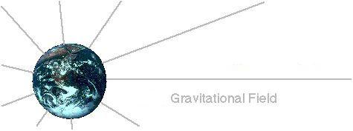
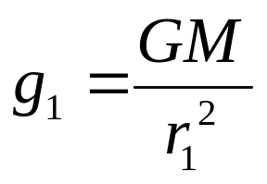
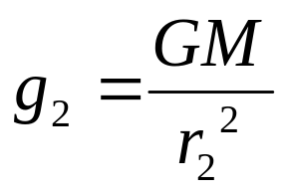
g varies with distance r
r₁
m
m
g₁
r₂
g₂
m
M
M_{E}
As r₁ < r₂
Therefore, g₁ > g₂
g decreases with distance

Slide 21
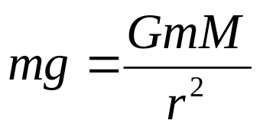
g and Gravitational Force
r
m
M
The gravitational force on a mass m at a particular point is therefore:
= mass × field strength at that point
= mg
Hence,

Slide 22
Calculating g: Example 1
The Earth may be considered to be a sphere of mass 6.0 × 10²⁴ kg and radius 6.38 × 10⁶ m.
(a) Calculate the gravitational field strength of Earth
(i) on it’s surface
(ii) at a distance of 3.8 × 10⁸ m from its centre
(b) Determine the weight of a 36 kg, placed
(i) on Earth’s surface
(ii) At a distance as stated in (a) (ii)
Solution:
(a) (i) g = GM/R²
= (6.67 × 10⁻¹¹ × 6.0 × 10²⁴ ) / (6.38 × 10⁶)²
= 9.8 Nkg⁻¹
(ii) g = GM/R²
= (6.67 × 10⁻¹¹ × 6.0 × 10²⁴ ) / (3.8 × 10⁸)²
= 2.8 × 10⁻³ Nkg⁻¹
(b) (i) weight = mg = 36 × 9.8 = 352 N
(ii) weight = mg = 36 × 2.8 × 10⁻³ = 0.10 N

Slide 23
Calculating g: Example 2
(a) Calculate the value of g at the surface of Mars where its mass is 6.42 × 10²³ kg and its radius 3.40 × 10⁶ m
(b) What is the weight or the gravitational force acting on a mass of 36 kg placed on the surface of Mars?
(G = 6.67 × 10⁻¹¹ Nm²kg⁻²)
Solution:
(a) g = GM_{M} / R²
= (6.67 × 10⁻¹¹ × 6.42 × 10²³) / (3.40 × 10⁶)²
= 3.70 Nkg⁻¹
(b) Weight = mg = 36 × 3.70 = 133 N

Slide 24
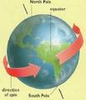
Factors Affecting g at Earth’s Surface
On Earth, the gravitational field strength g at its surface is affected by:
Altitude and depth
Latitude
Rotation of the Earth

Slide 25
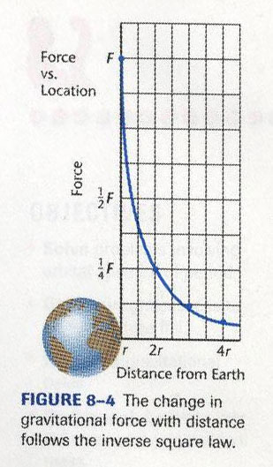
Effect of Altitude on g
g = G M / r²
g ∝ 1 / r²
Therefore the graph follows the inverse square law.

Slide 26
Effect of Depth on g
g = G M / r²
g ∝ 1 / r²
Will g approach infinity when r approaches zero? ……

Slide 27
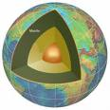
g Below Earth’s Surface
As we go below Earth’s surface, the mass of Earth affecting us decreases according to the change in volume:
g = GM / R²
= G ρV / r²
= G ρ(4/3 π r³) / r²
= G ρ(4/3 π r)
= (4/3 π ρ G) r
= k r
Therefore, g ∝ r
ρ = m/V
V = 4/3 πr³
Assuming the Earth is a perfect sphere and has uniform density.

Slide 28
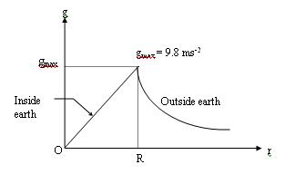
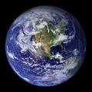
Effect of Altitude & Depth
Above the earth’s surface g ∝ 1 / r²
Below the earth’s surface, g ∝ r
Assumption:
The Earth is spherical and homogenous.
*Gravitational field strength at the centre of the earth is zero. This is because any matter at the centre would be pulled equally in all direction, giving a resultant force on it as zero.

Slide 29
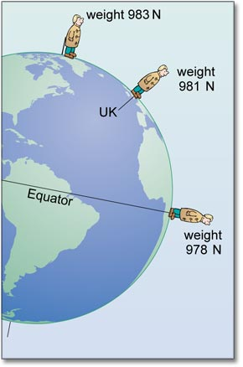
Effect of Latitude
The Earth is not spherical but ellipsoidal.
The equatorial radius actually exceeds the polar radius by 21 km.
Hence measured values of g will show an increase as we proceeds from Equator to either pole.

Slide 30
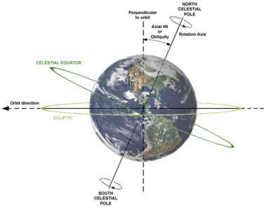
Effect of Earth’s Rotation
The Earth rotates about a polar axis, hence masses on the surface of the Earth rotates in circle of decreasing radius from the equator to the poles.
Therefore:
g is minimum at Equator where centripetal effects are the greatest.
g is maximum at the poles, where centripetal effects are not felt.

Slide 31
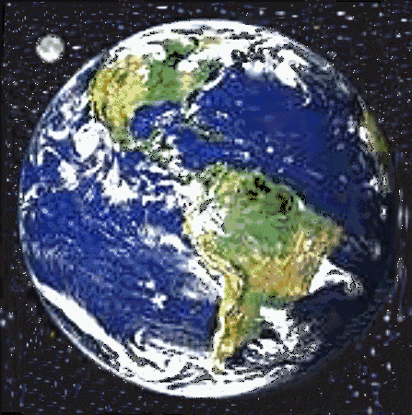
Problem Solving 1:
Finding Density of the Earth
The Earth may be considered to be a sphere of mass 6.0 × 10²⁴ kg and radius 6.38 × 10⁶ m. Calculate the density of Earth.
Why is the calculated density of Earth just an average value?
Solution:
ρ_{E} = M_{E} / V
= 6.0 × 10²⁴ / [4/3 π (6.38 × 10⁶)³ ]
= 5.5 × 10³ kgm⁻³
This value is only an average value as the Earth is not a perfect sphere and is not homogenous, it in fact gets denser nearer the core.

Slide 32
Problem Solving 2
The mass of earth is approximately 80 times the mass of the moon and the earth’s radius is 3.7 times that of the moon. If the acceleration of free fall on the earth is 10 ms⁻², estimate its value on the moon.
Solution:
g = GM_{E} / R_{E}²
Therefore,
G (80 M_{M}) / (3.7 R_{M})² = 10
G M_{M} / R_{M}² = (3.7)² × 10 / 80
= 1.7 ms⁻²

Slide 33
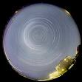
Problem Solving 3
A certain star of mass M and radius r rotates so rapidly that material at its equator only just remains on its surface. Given that the gravitational constant is G, find the period of rotation of the star in terms of G, M and r.
Solution:
gravitational force = centripetal force
mg = mrω²
m GM / r² = m r ω²
ω² = GM / r³
= √ (GM / r³ )
T = 2π / ω
= 2π / √ (GM / r³ )

Slide 34
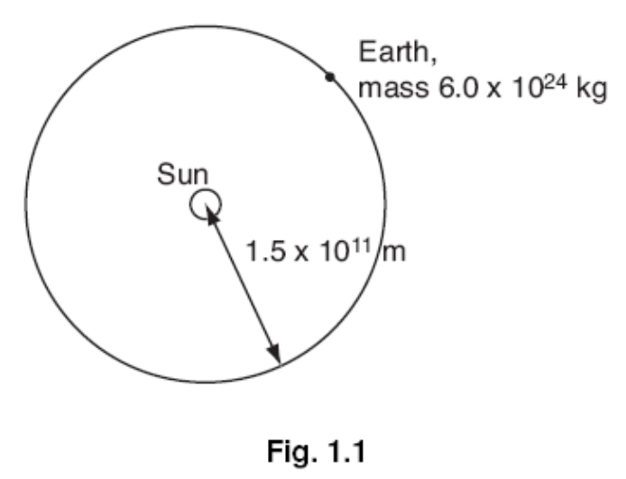
Practice 1
The orbit of the Earth, mass 6.0 × 10²⁴ kg, may be assumed to be a circle of radius 1.5 × 10¹¹ m with the Sun at its centre, as illustrated in Fig. 1.1.
The time taken for one orbit is 3.2 × 10⁷ s.
(a) Calculate
(i) the magnitude of the angular velocity
of the Earth about the Sun,
(ii) the magnitude of the centripetal
force acting on the Earth.
(b) (i) State the origin of the centripetal force calculated in (a)(ii).
(ii) Determine the mass of the Sun.

Slide 35
Solution 1
(a) (i) angular speed = 2π/T
ω = 2π/(3.2 × 10⁷)
= 1.96 × 10⁻⁷ rad s⁻¹
(ii) Force = mrω²
= 6.0 × 10²⁴ × 1.5 × 10¹¹ × (1.96 × 10⁻⁷)²
= 3.46 × 10²² N
(b) (i) gravitation/gravity/gravitational field (strength)
(ii) F = GMm/r²
3.46 × 10²² = (6.67 × 10⁻¹¹ × M × 6.0 × 10²⁴)/(1.5 × 10¹¹)²
M = 1.95 × 10³⁰ kg
T = 1 yr
= 365 × 24 × 3600
= 3.2 × 10⁷ s

Slide 36
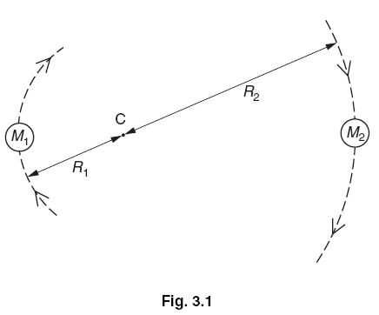
Practice 2
A binary star consists of two stars that orbit about a fixed point C, as shown in Fig. 3.1.The star of mass M₁ has a circular orbit of radius R₁ and the star of mass M₂ has a circular orbit of radius R₂. Both stars have the same angular speed ω, about C.
(a) State the formula, in terms of G, M₁, M₂, R₁, R₂ and ω for
(i) the gravitational force between the two stars,
(ii) the centripetal force on the star of mass M₁.
(b) The stars orbit each other in a time of 1.26 × 10⁸ s (4.0 years). Calculate the angular speed ω for each star.
(c) (i) Show that the ratio of the masses of the stars is given by the expression M₁/M₂ = R₂/R₁
(ii) The ratio M₁/M₂ is equal to 3.0 and the separation of the stars is 3.2 × 10¹¹ m. Calculate the radii R₁ and R₂
(d) (i) By equating the expressions you have given in (a) and using the data calculated in (b) and (c), determine the mass of one of the stars.
(ii) State whether the answer in (i) is for the more massive or for the less massive star.

Slide 37
Solution 2
(a) (i) (force) = GM₁M₂/(R₁ + R₂)²
(ii) (force) = M₁R₁ω² or M₂R₂ω²
(b) ω = 2π/(1.26 x 10⁸) or 2π/T
= 4.99 x 10⁻⁸ rad s⁻¹
(c) (i) reference to either taking moments (about C) or same (centripetal) force
M₁R₁ = M₂R₂ or M₁R₁ω= M₂R₂ω
hence M₁/M₂ = R₂/R₁
(ii) R₂ = 3/4 x 3.2 x 10¹¹ m = 2.4 x 10¹¹ m
R₁ = (3.2 x 10¹¹) – R₂ = 8.0 x 10¹⁰ m (allow vice versa)
(d) (i) M₂ = {(R₁ + R₂)² x R₁ x ω²} I G (any subject for equation)
= (3.2 x 10¹¹)² x 8.0 x 10¹⁰ x (4.99 x 10⁻⁸)²/(6.67 x 10⁻¹¹)
= 3.06 x 10²⁹ kg
(ii) less massive (only award this mark if reasonable attempt at (i))
(9.17 x 10²⁹ kg for more massive star)

Slide 38
THE END

